Slide 1
A Novel Approach for Identifying Collision Asteroid Families in the Kuiper Belt
Aditya Kendre

Slide 2
Statement of Purpose
The purpose of this investigation is to explore the evolution of Kuiper belt objects, shed light on new methods of finding new asteroid family.

Slide 3
Question
Can the Haumea asteroid collisional family can be distinguished from the background objects in the Kuiper belt, and which clustering techniques and/or algorithms are the most efficient in identifying the Haumea family? Can these techniques be used to distinguish other families?

Slide 4
Hypothesis
Collisional families located will be able to be distinguished from background objects in the Kuiper belt, and the Hierarchical Clustering method will be the most efficient way in distinguishing the Haumea asteroid collisional family from the background objects in the Kuiper belt.

Slide 5
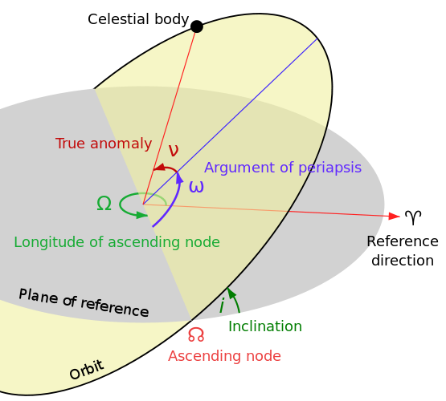
Proper Elements
Eccentricity (e) – elliptical shape of the orbit, described in a range between 0 – 1, where 0 is a perfect circle
Semi-major axis (a) – greater distance from center of an ellipse to the outer.
Inclination (i) – the vertical tilt of the orbit
Semi-major axis (a)
Eccentricity (e)

Slide 6
Methods

Slide 7
Problems

